Slide 1
Unsupervised Machine Learning: Clustering Techniques on Dry Bean Dataset
Nariman Pashayev

Slide 2
Contents
Main Objectives
Data Description
Data Exploration And Analysis
Machine Learning Analysis and Modelling
Key Findings and Recommendations

Slide 3
Main Objectives
There is a wide range of genetic diversity of dry bean which is the most produced one among the edible legume crops in the world. Seed quality is definitely influential in crop production. Therefore, seed classification is essential for both marketing and production to provide the principles of sustainable agricultural systems. The primary objective of this study is to provide a method for obtaining uniform seed varieties from crop production, which is in the form of population, so the seeds are not certified as a sole variety. Thus, a computer vision system was developed to distinguish seven different registered varieties of dry beans with similar features in order to obtain uniform seed classification. For the classification model, images of 13,611 grains of 7 different registered dry beans were taken with a high-resolution camera. A total of 16 features, 12 dimensions and 4 shape forms were obtained from the grains.
Originally this dataset was obtained for predicting Classification problem. But, in my analysis I used this as Clustering analysis and for this purpose I assumed I don’t know the Dry Bean Classes, hence Unsupervised Learning.
Then, I compared my obtained results with the experimentally obtained Classes to measure my models’ performance, but in real cases it is not usually possible, since this is Unsupervised Learning
Link to Dataset: https://www.muratkoklu.com/datasets/

Slide 4
1. DATA DESCRIPTION

Slide 5
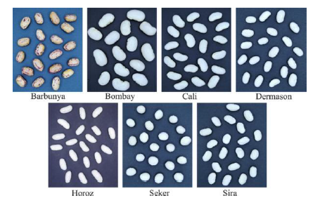
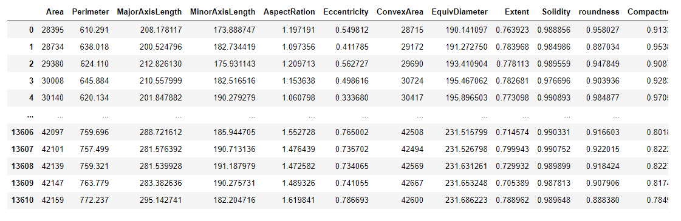
Dataset Description
Dataset contains 13611 samples and 16 features plus target variable “Class”
Target variable contains 7 different classes : Seker, Barbunya, Bombay, Cali, Dermosan, Horoz and Sira

Slide 6
Dataset Description-Attribute Information
 | Feature Name | Feature Description
1 | Area (A) | The area of a bean zone and the number of pixels within its boundaries.
2 | Perimeter (P) | Bean circumference is defined as the length of its border.
3 | Major axis length (L) | The distance between the ends of the longest line that can be drawn from a bean.
4 | Minor axis length (l) | The longest line that can be drawn from the bean while standing perpendicular to the main axis.
5 | Aspect ratio (K) | Defines the relationship between L and l.
6 | Eccentricity (Ec) | Eccentricity of the ellipse having the same moments as the region.
7 | Convex area (C) | Number of pixels in the smallest convex polygon that can contain the area of a bean seed.
8 | Equivalent diameter (Ed) | The diameter of a circle having the same area as a bean seed area.
9 | Extent (Ex) | The ratio of the pixels in the bounding box to the bean area.
10 | Solidity (S) | Also known as convexity. The ratio of the pixels in the convex shell to those found in beans.
11 | Roundness (R) | Calculated with the following formula: (4piA)/(P^2)
12 | Compactness (CO): | Measures the roundness of an object: Ed/L
13 | ShapeFactor1 (SF1)
14 | ShapeFactor2 (SF2)
15 | ShapeFactor3 (SF3)
16 | ShapeFactor4 (SF4)
17 | Class | Seker, Barbunya, Bombay, Cali, Dermosan, Horoz and Sira

Slide 7
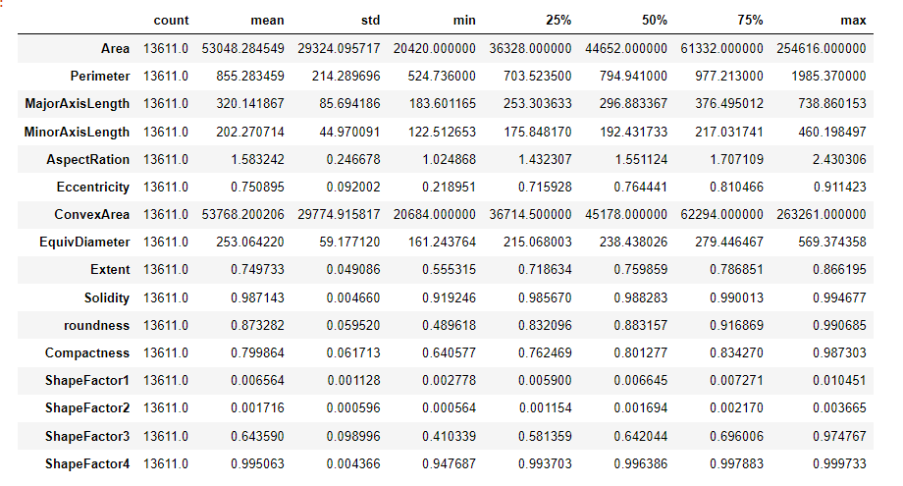
Dataset Description-Basic Statistics

Slide 8
2. Exploratory Data Analysis
and Feature Engineering

Slide 9
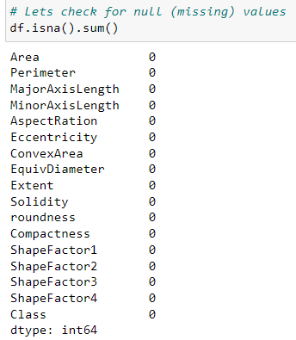
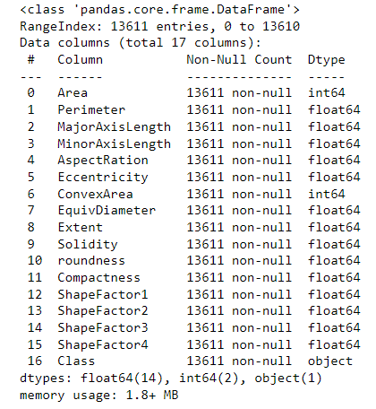
EDA-Checking for Data Types and Missing Values
All features hold numeric values (both int and float type), and the last column is "object" type.
There are not missing values in the dataset.

Slide 10
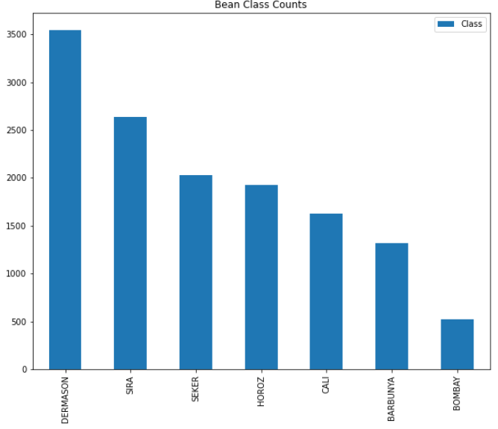
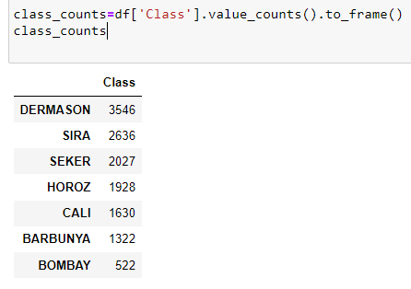
EDA-Checking for Target Variable
Since this is Clustering example, we will not need y-variable (Class variable) as an input in my clustering analysis.
However, lets check how many classes we have and how many samples of each class we have
As you can see the data is not evenly split between target values, quite imbalanced.

Slide 11
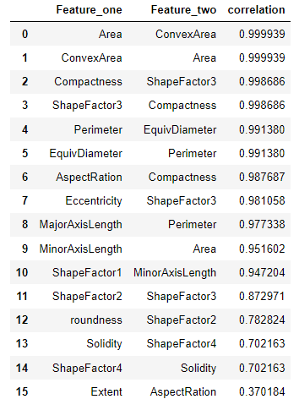
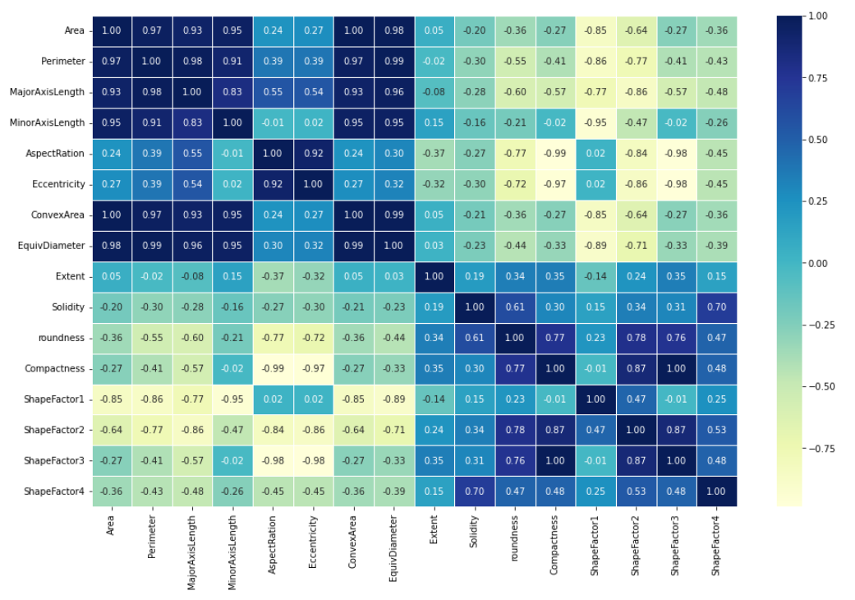
EDA-Checking Feature Correlations
Some features are strongly correlated to each other, like 'Area-ConvexArea', 'compactness-shape_factor_3', 'Perimeter-EquivDiameter‘, ‘AspectRation-Compactness’, ‘Eccentricity-ShapeFactor3’, ‘MajorAxisLength-Perimeter’, ‘MinorAxisLength-Area’, etc.

Slide 12
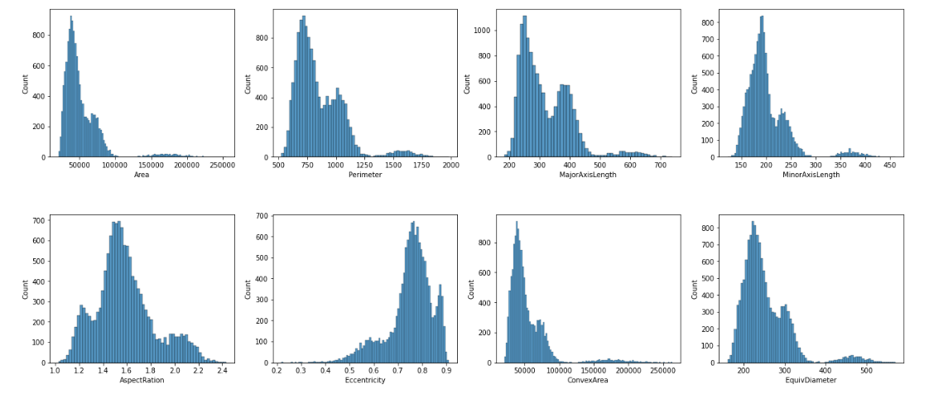
EDA-Features Distributions 1
The plots show that values in some features have similar distribution (e.g., "area", "perimeter", "major" and "minor" axis length), whereas others are completely different.
Some of the features are skewed
Distribution shapes of some features suggest existence of outliers.

Slide 13
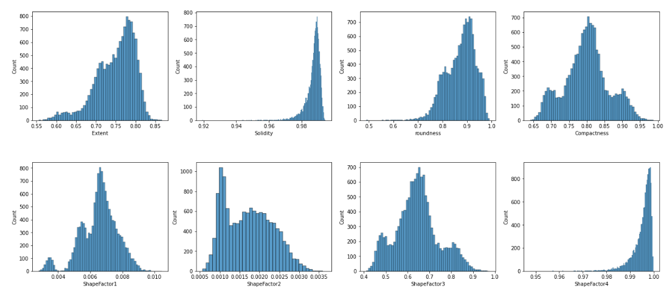
EDA-Features Distributions 2

Slide 14
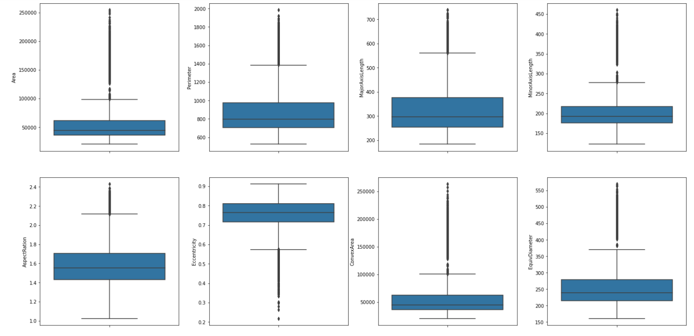
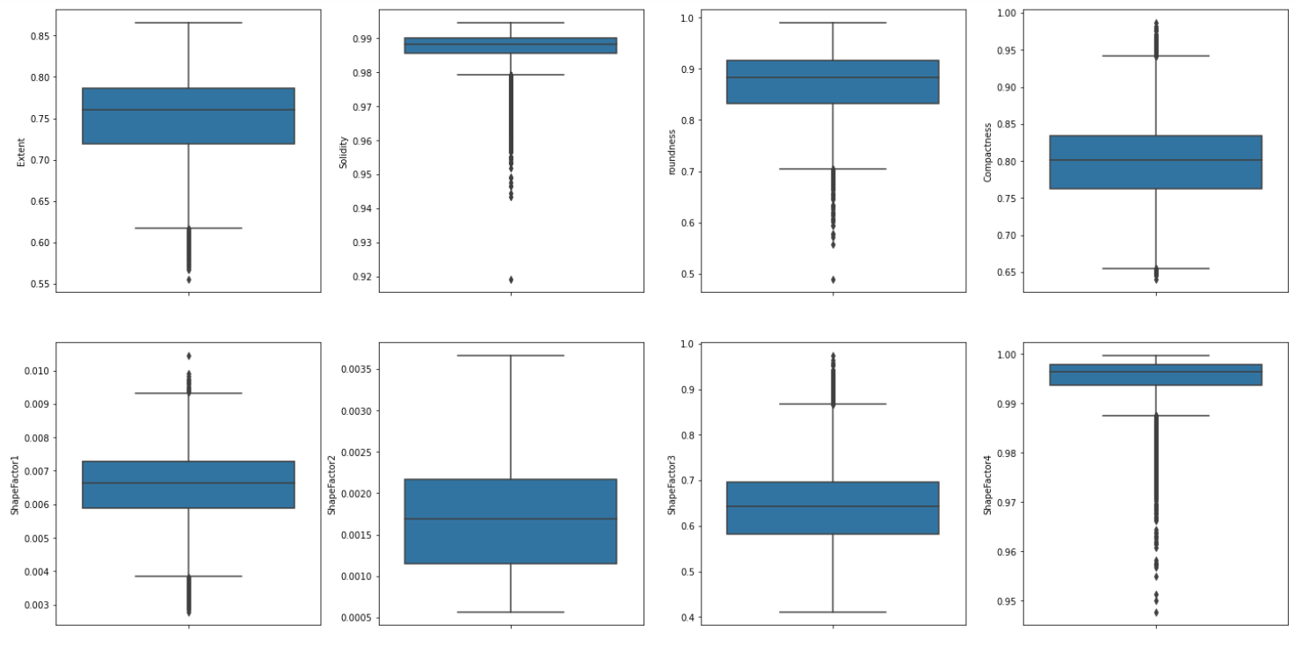
EDA-Checking for Outliers
There are a lot of outliers in most of the features

Slide 15
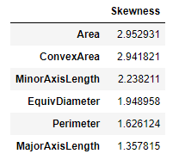
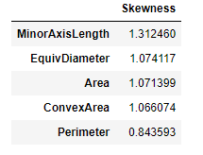
EDA-Checking for Skewness
Log transformation applied to Skewed variables greater than 0.75
Before Log Transformation
After Log Transformation
Log Transformation

Slide 16
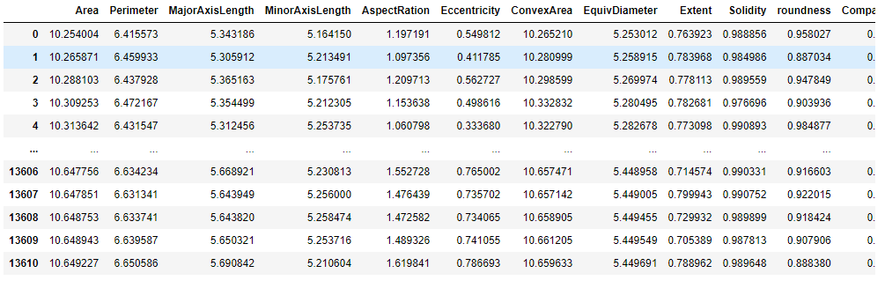
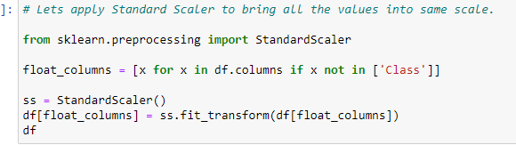
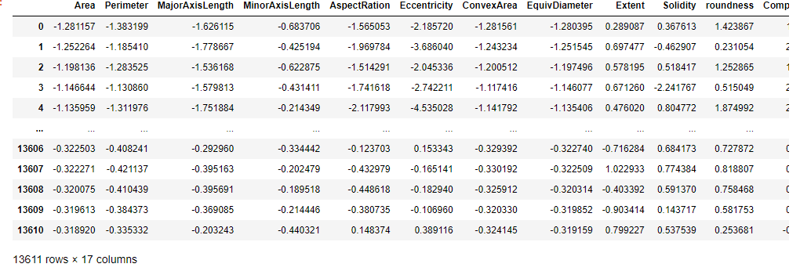
EDA-Feature Scaling
For models which use distance as metric in its calculations, feature scaling plays vital role.
All unsupervised models I used in my analysis uses distance metrics, so we need feature scaling before beginning Machine learning section
Sklearn’s StandardScaler applied

Slide 17
3. Clustering Techniques and Findings

Slide 18
Clustering Introduction
In the following slides, I will show 4 different clustering techniques applied on this dataset and discuss the key findings
K-Means Clustering
Hierarchical Agglomerative Clustering
DBSCAN Algorithm
MeanShift Algorithm

Slide 19
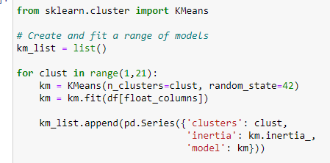
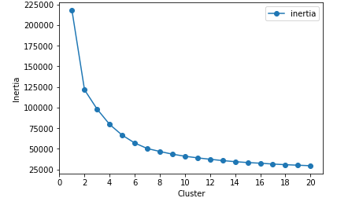
Clustering 1: K-Means Algorithm 1
In order to find the optimal number of cluster, I run the model with clusters ranging from 1 to 20
Then, for each model, I stored the number of clusters and respective inertia value
Finally, plotted cluster number vs inertia to find the optimal cluster size
Inertia plot shows 7-8 clusters as an optimal size

Slide 20

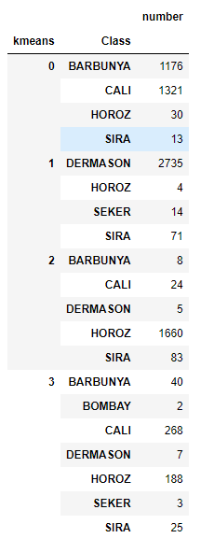
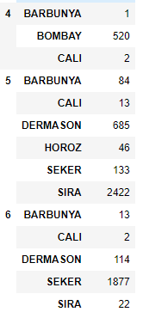
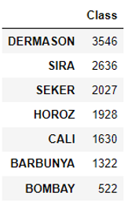
Clustering 1: K-Means Algorithm 2
Here, I applied Kmeans algorithm to the dataset with 7 clusters
Index | Class Name | Predicted:Actual | Prediction Accuracy (%)
0 | Barbunya | 1176:1322 | 88.96
1 | Dermason | 2735:3546 | 77.13
2 | Horzo | 1660:1928 | 86.10
3 | Cali | 268:1630 | 16.44
4 | Bombay | 520:522 | 99.17
5 | Sira | 2422:2636 | 91.88
6 | Seker | 1877:2027 | 92.60
Predicted Classes
Actual Classes
I can say that, K-Means outcomes were satisfactory for 6 clusters
Only Cali was predicted poorly-16%, because of similar characteristics with Cluster Barbunya

Slide 21

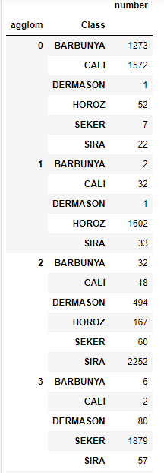
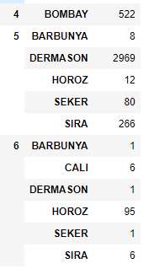
Clustering 2: Hierarchical Agglomerative Clustering
Here, I applied Agglomerative clustering algorithm to the dataset with 7 clusters
Index | Class Name | Predicted:Actual | Prediction Accuracy (%)
0 | Barbunya | 1273:1322 | 96.30
1 | Horzo | 1602:1928 | 83.73
2 | Sira | 2252:2636 | 83.09
3 | Seker | 1879:2027 | 0.37
4 | Bombay | 522:522 | 100
5 | Dermason | 2969:3546 | 85.43
6 | Cali | 6:1630 | 92.70
Predicted Classes
Actual Classes
Again, I can say that, outcomes were satisfactory for 6 clusters
Only Cali was predicted poorly-0.37%, because of similar characteristics with Cluster Barbunya

Slide 22
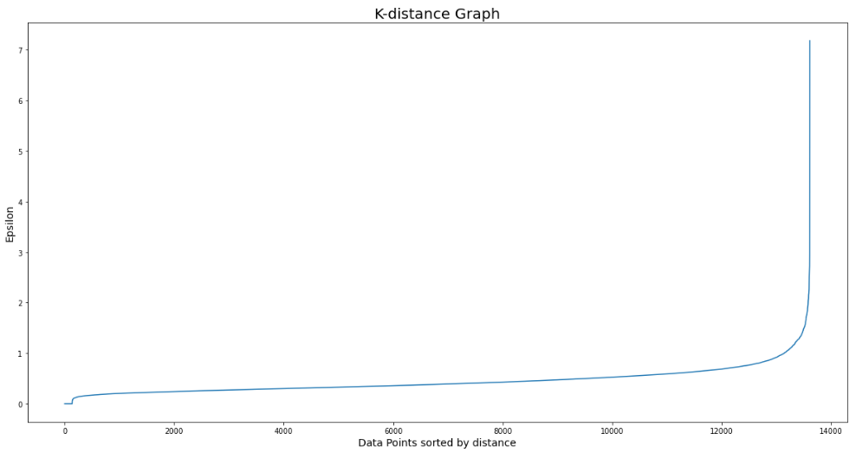

Clustering 3: DBSCAN Algorithm 1
Minimum Samples (“MinPts”)
There is no automatic way to determine the MinPts value for DBSCAN.
Here are a few rules of thumb for selecting the MinPts value:
Generally, MinPts should be greater than or equal to the dimensionality of the data set
If your data has more than 2 dimensions, choose MinPts = 2*dim, where dim= the dimensions of your data set (Sander et al., 1998).
In this example, my data contains 16 features, 16 dimensional data then. So, MinSamples=16 is chosen
Epsilon (ε)
After I selected my MinPts value, I used NearestNeighbors from Scikit-learn, to calculate the average distance between each point and its n_neighbors.
The one parameter you need to define is n_neighbors, which in this case is the value you choose for MinPts=16.
Lets find the epsilon now. For epsilon, I am using the K-distance graph. For plotting a K-distance Graph, we need the distance between a point and its nearest data point for all data points in the dataset. We obtain this using NearestNeighbors from sklearn.neighbors.
The optimum value of epsilon is at the point of maximum curvature in the K-Distance Graph, which is 0.65 in this case.

Slide 23
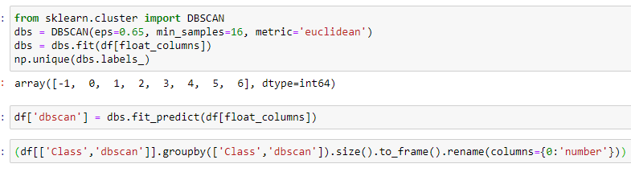
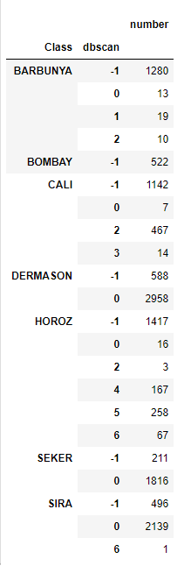
Clustering 3: DBSCAN Algorithm 2
As it is seen, DBSCAN gave unrealistic results here, since it predicted most of the clusters as outliers

Slide 24
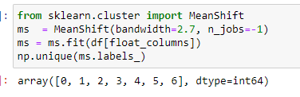
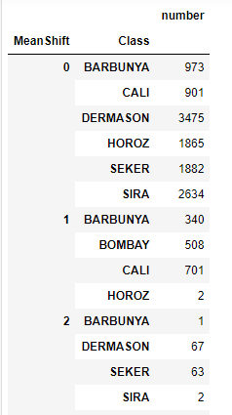
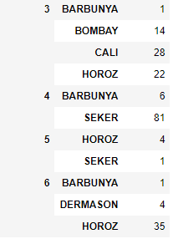
Clustering 4: MeanShift Algorithm
Predicted Classes
Actual Classes
MeanShift algorithm also performed poorly at clustering the Bean classes.

Slide 25
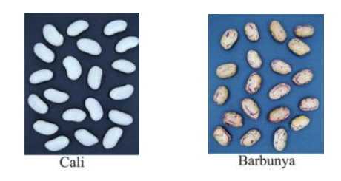
Results and Key Findings
There are some features which highly correlated to each other that can affect the model performance
Also, there are quite amount of outliers for most of the features, which also can affect the model performance badly if not excluded
Some of the features are skewed and log transformed before applying different clustering techniques
Out of 4 algorithms tested, only 2 of them gave good results: K-Means and Agglomerative Clustering
Only Class Cali was predicted poorly, because of similar characteristics with Cluster Barbunya
DBSCAN and MeanShift performed poorly at clustering the Beans into classes
My Github for Jupyter file: https://github.com/NARIMANPASHA/Unsupervised-Learning-Clustering-on-Dry-Bean-Dataset.git
Suggestions
To predict the class CALI more accurately, there should be “Color” column in the dataset, so to avoid the similarity with class Barbunya.
Class Name | K-Means Accuracy (%) | Agglomerative Accuracy (%)
Barbunya | 88.96 | 96.3
Dermason | 77.13 | 83.73
Horzo | 86.10 | 83.09
Cali | 16.44 | 0.37
Bombay | 99.17 | 100
Sira | 91.88 | 85.43
Seker | 92.6 | 92.70

